Slide 1
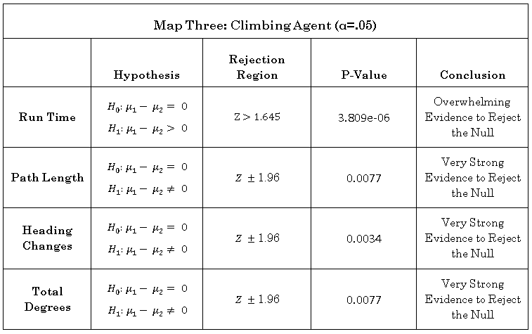
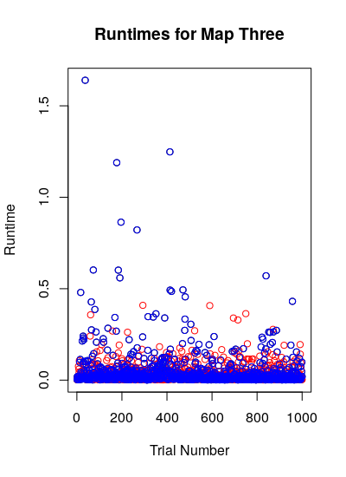
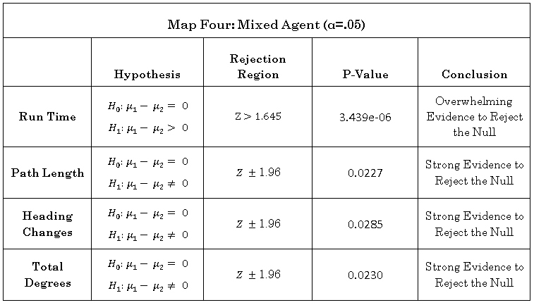
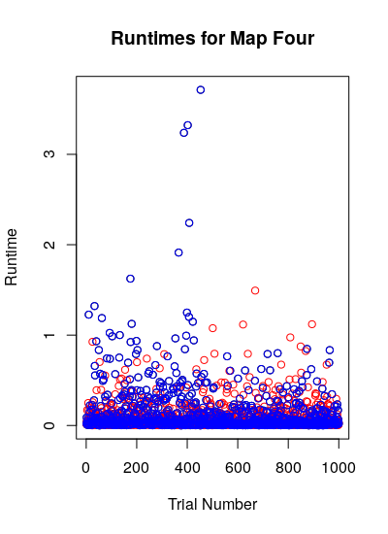
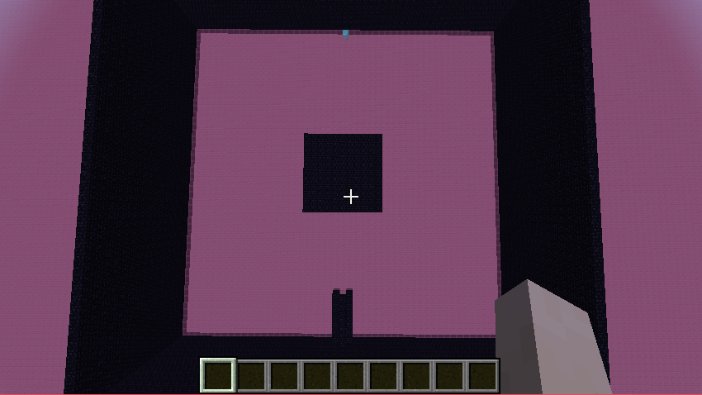
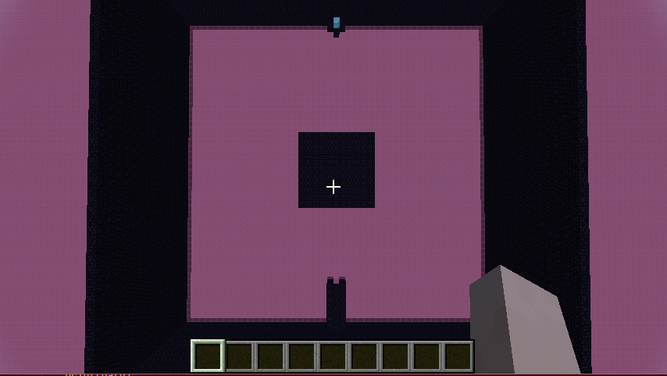
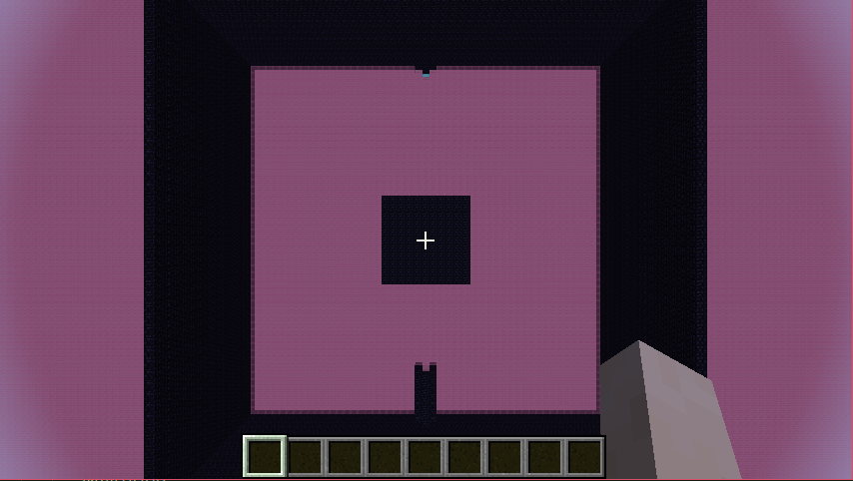
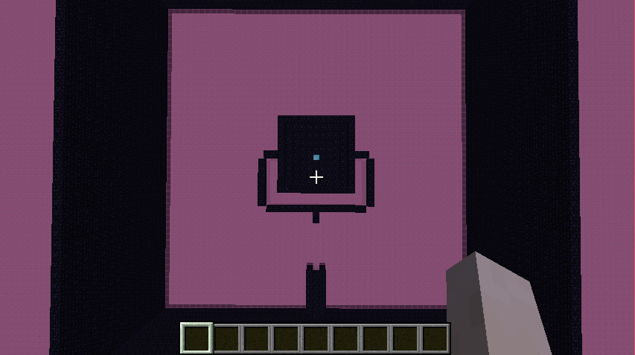
Randomized 3D Path Planning in Discrete Minecraft Worlds
Christen Ford Project Mentor: Andrew Watkins
Computer Science, Baldwin Wallace University Berea, Ohio 44017 Project #: 57
Introduction
Path planning is widely utilized in the entertainment, robotics, and automotive industries however, it has not seen much innovation in recent years. Most modern applications of path planning involve using classical algorithms or derived works.
Minecraft is a diverse simulation that enables us to build complex worlds perfect for testing new forms of path planning. For those unaware, Minecraft is a video game that allows the player to craft worlds from pure imagination using various types of blocks. These worlds exhibit true to life behaviors in the forms of dynamic fauna and flora that enact unique challenges on any serious path planning algorithm.
This work focuses on the application of a specific path planning algorithm known as a rapidly exploring random tree (RRT for short) that is let loose on a series of controlled Minecraft worlds. In addition, we speed up our algorithm by using a graphics card to perform calculations. Our algorithm is called RRT-GPU.
Results
Our research set out to verify that the run time of RRT-GPU differed from RRT. Our Z-Tests indicated that RRT-GPU outperformed RRT on maps three and four, but failed to do so on maps one and two. Our Z-Tests were single tailed and were conducted with an α value of “0.05”.
Conclusions
You can, of course, start your conclusions in column #3 if your results section is “data light.”
Conclusions should not be mere reminders of your results. Instead, you want to guide the reader through what you have concluded from the results. What is the broader significance? Would anyone be mildly surprised? Why should anyone care? This section should refer back, explicitly, to the “burning issue” mentioned in the introduction. If you didn’t mention a burning issue in the introduction, go back and fix that -- your poster should have made a good case for why this experiment was worthwhile.
Blah, blah, blah. Blah, blah, blah. Blah, blah, blah. Blah, blah, blah. Blah, blah, blah. Blah, blah, blah. Blah, blah, blah. Blah, blah, blah. Blah, blah, blah. Blah, blah, blah. Blah, blah, blah. Blah, blah, blah. Blah, blah, blah. Blah, blah, blah. Blah, blah, blah. Blah, blah, blah. Blah, blah, blah. Blah, blah, blah. Blah, blah, blah. Blah, blah, blah. Blah, blah, blah. Blah, blah, blah. Blah, blah, blah.
In the following two charts, we show a comparison between the run times (seconds) of RRT and RRT-GPU across maps three and four. You will notice that RRT has several trials that greatly exceed the run time of RRT.
Legend
RRT | Blue
RRT-GPU | Red
Materials and methods
We gathered data on an MSI GT62VR 7RE laptop equipped with an NVidia GTX 1070 graphics card. In addition, we analyzed RRT-GPU in light of four metrics:
Run Time
Path Length
Number of Heading Changes
Total Path Degrees
We were primarily concerned with determining whether RRT-GPU outperformed RRT in terms of run time.
To do this, we let the algorithms run 1,000 times on four maps and conducted both an F-Test and Z-Test on the results:
Literature cited
Johnson M., Hofmann K., Hutton T., Bignell D. (2016) The Malmo Platform for Artificial Intelligence Experimentation. Proc. 25th International Joint Conference on Artificial Intelligence, Ed. Kambhampati S., p. 4246. AAAI Press, Palo Alto, California USA. https://github.com/Microsoft/malmoBrooks, L.D. 1988. The evolution of recombination rates. Pages 87-105 in The Evolution of Sex, edited by R.E. Michod and B.R. Levin. Sinauer, Sunderland, MA.
Andreas Klöckner, Nicolas Pinto, Yunsup Lee, Bryan Catanzaro, Paul Ivanov, Ahmed Fasih, PyCUDA and PyOpenCL: A scripting-based approach to GPU run-time code generation, Parallel Computing, Volume 38, Issue 3, March 2012, Pages 157-174.
Acknowledgments
We thank Doctor Andrew Watkins of Baldwin Wallace University for serving as a mentor and guide for this thesis. Without his help, we would have still been stuck fiddling with the graphics hardware components of this thesis. We would also like to thank Andreas Klöckner of UI Urbana-Champaign for providing excellent reference materials and examples for working with the PyCuda graphics acceleration library. We would also like to thank the team at Microsoft Research responsible for Project Malmö, without them we would have no way to visualize what RRT-GPU does or to properly test it.
Map One
Map Two
For further information
Please contact cford15@mail.bw.edu. More information on this and related projects can be obtained at:
https://github.com/gollum18/malmo_thesis.
This poster may be found at:
Map Three
Map Four

